Slide 1







RECYCLING REVOLUTION APP
SaafPakistan
LETS PAINT PAKISTAN GREEN!
Ali Sher
Nouman Ali
Mian Faizan Munawer

Slide 2
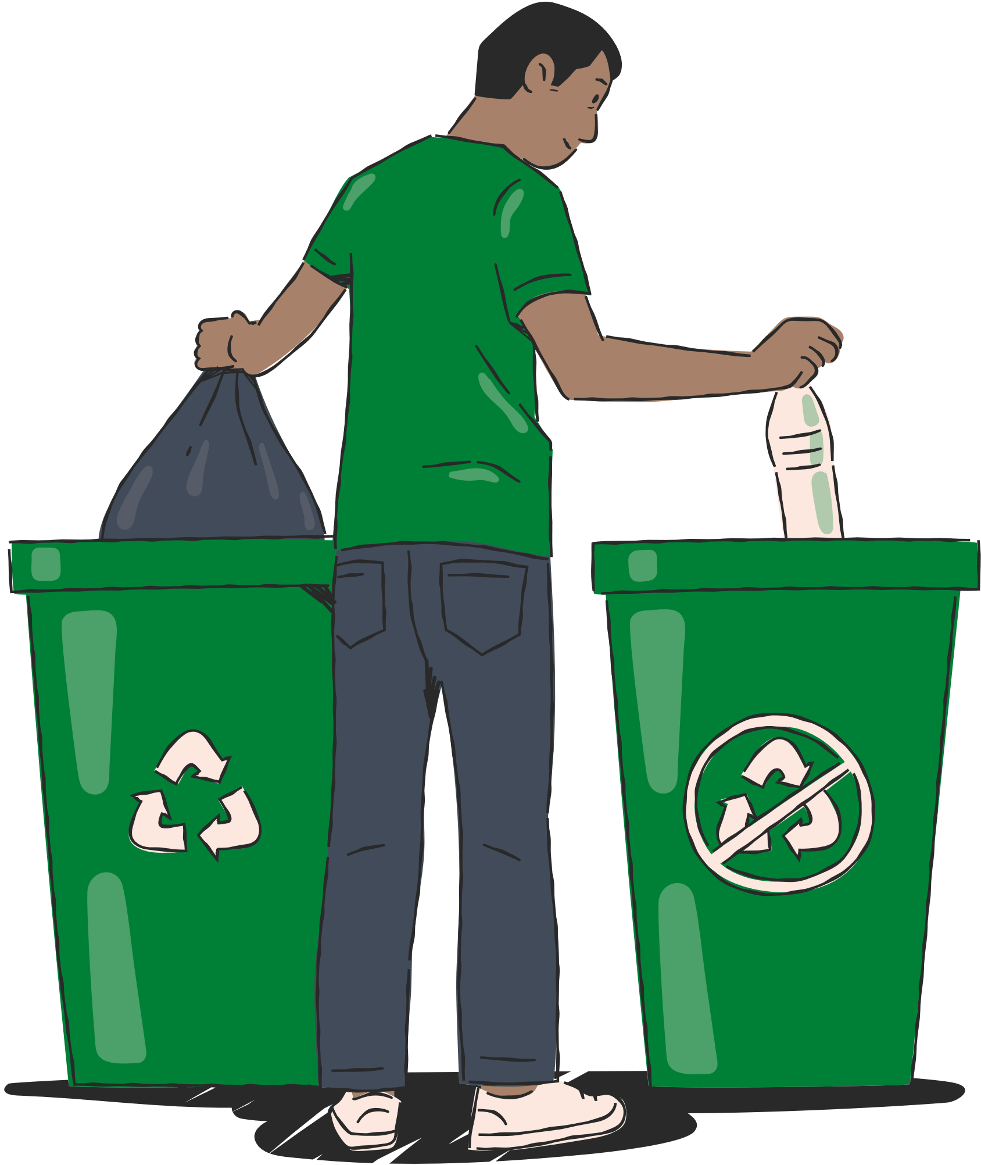
Problem
Pakistan's unstructured recycling system leads to disorganized waste disposal, causing environmental pollution and recyclable accumulation in landfills.

Slide 3

Statistics
Solid Waste Generation
City | Recyclable Waste Generated Daily/ Tons
Karachi | 16,500
Lahore | 7,690
Faisalabad | 5,017
Rawalpindi | 4,500
Hyderabad | 3,973
Pakistan waste generation grows 2.4% annually
Lahore Generates 7690 tons of waste on a daily basis
Only 35% of generated waste is recyclable.
Out of recyclable waste only 27% is being recycled
As of 2020, 190 acres of landfill are utilized, with a proposal for an additional 150 acres due to high waste generation
[1]
[1]
[2]
[3]
Solid Waste Generation In Major Cities
[1]
Waste Management in Pakistan (2022)by the U.S. Trade and Development Agency
Azam, M., et al. (2019). "Status, characterization, and potential utilization of municipal solid waste as a renewable energy source: Lahore case study in Pakistan."
COMPENDIUM ON ENVIRONMENT STATISTICS OF PAKISTAN 2020

Slide 4

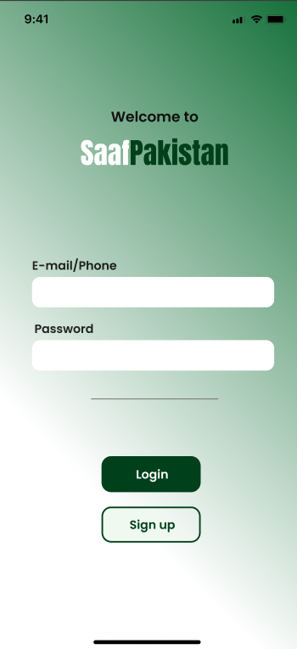
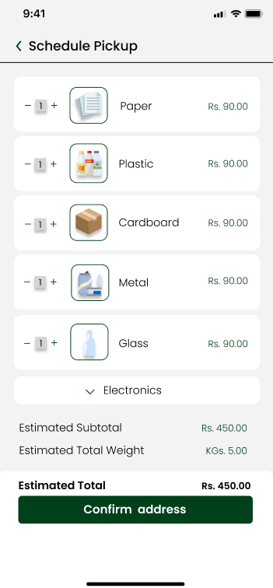
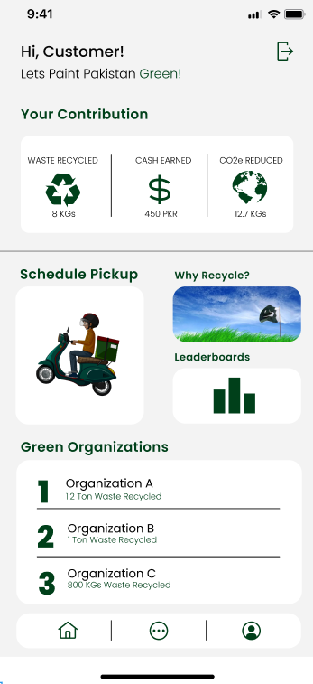
Solution
"Introducing SaafPakistan, Your App for a Cleaner, Greener Tomorrow!"

Slide 5
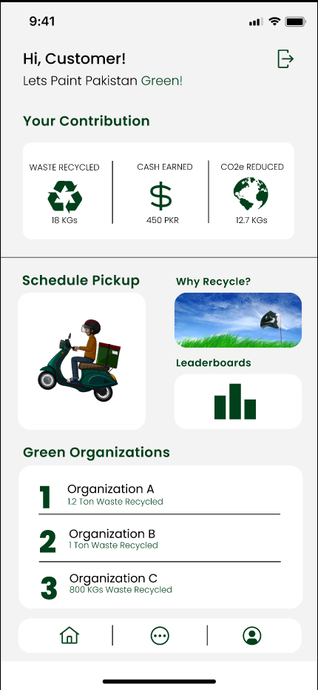
Features
Progress
PKR
Get updated of your real-time progress
Educational Content
Schedule Pickup for Recycling
Gamification
A dynamic leaderboard system for individuals and businesses, fostering a sense of competition.
Compete against friends
For Green Marketing

Slide 6
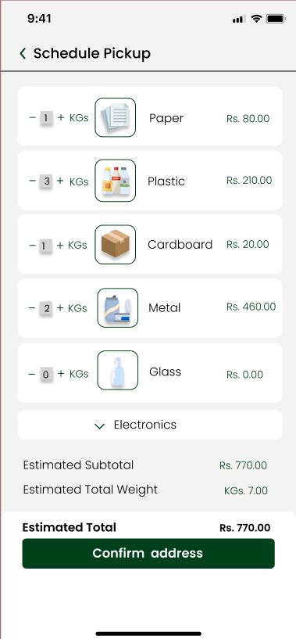

Schedule Pickups For Recycling
Sell Your Recyclables with the touch of button
From The comfort of your home

Slide 7
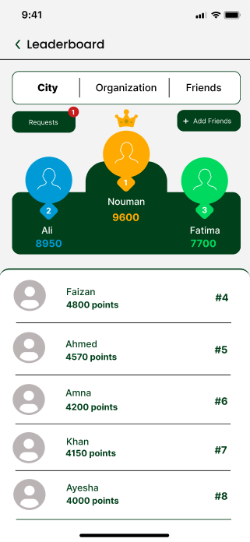
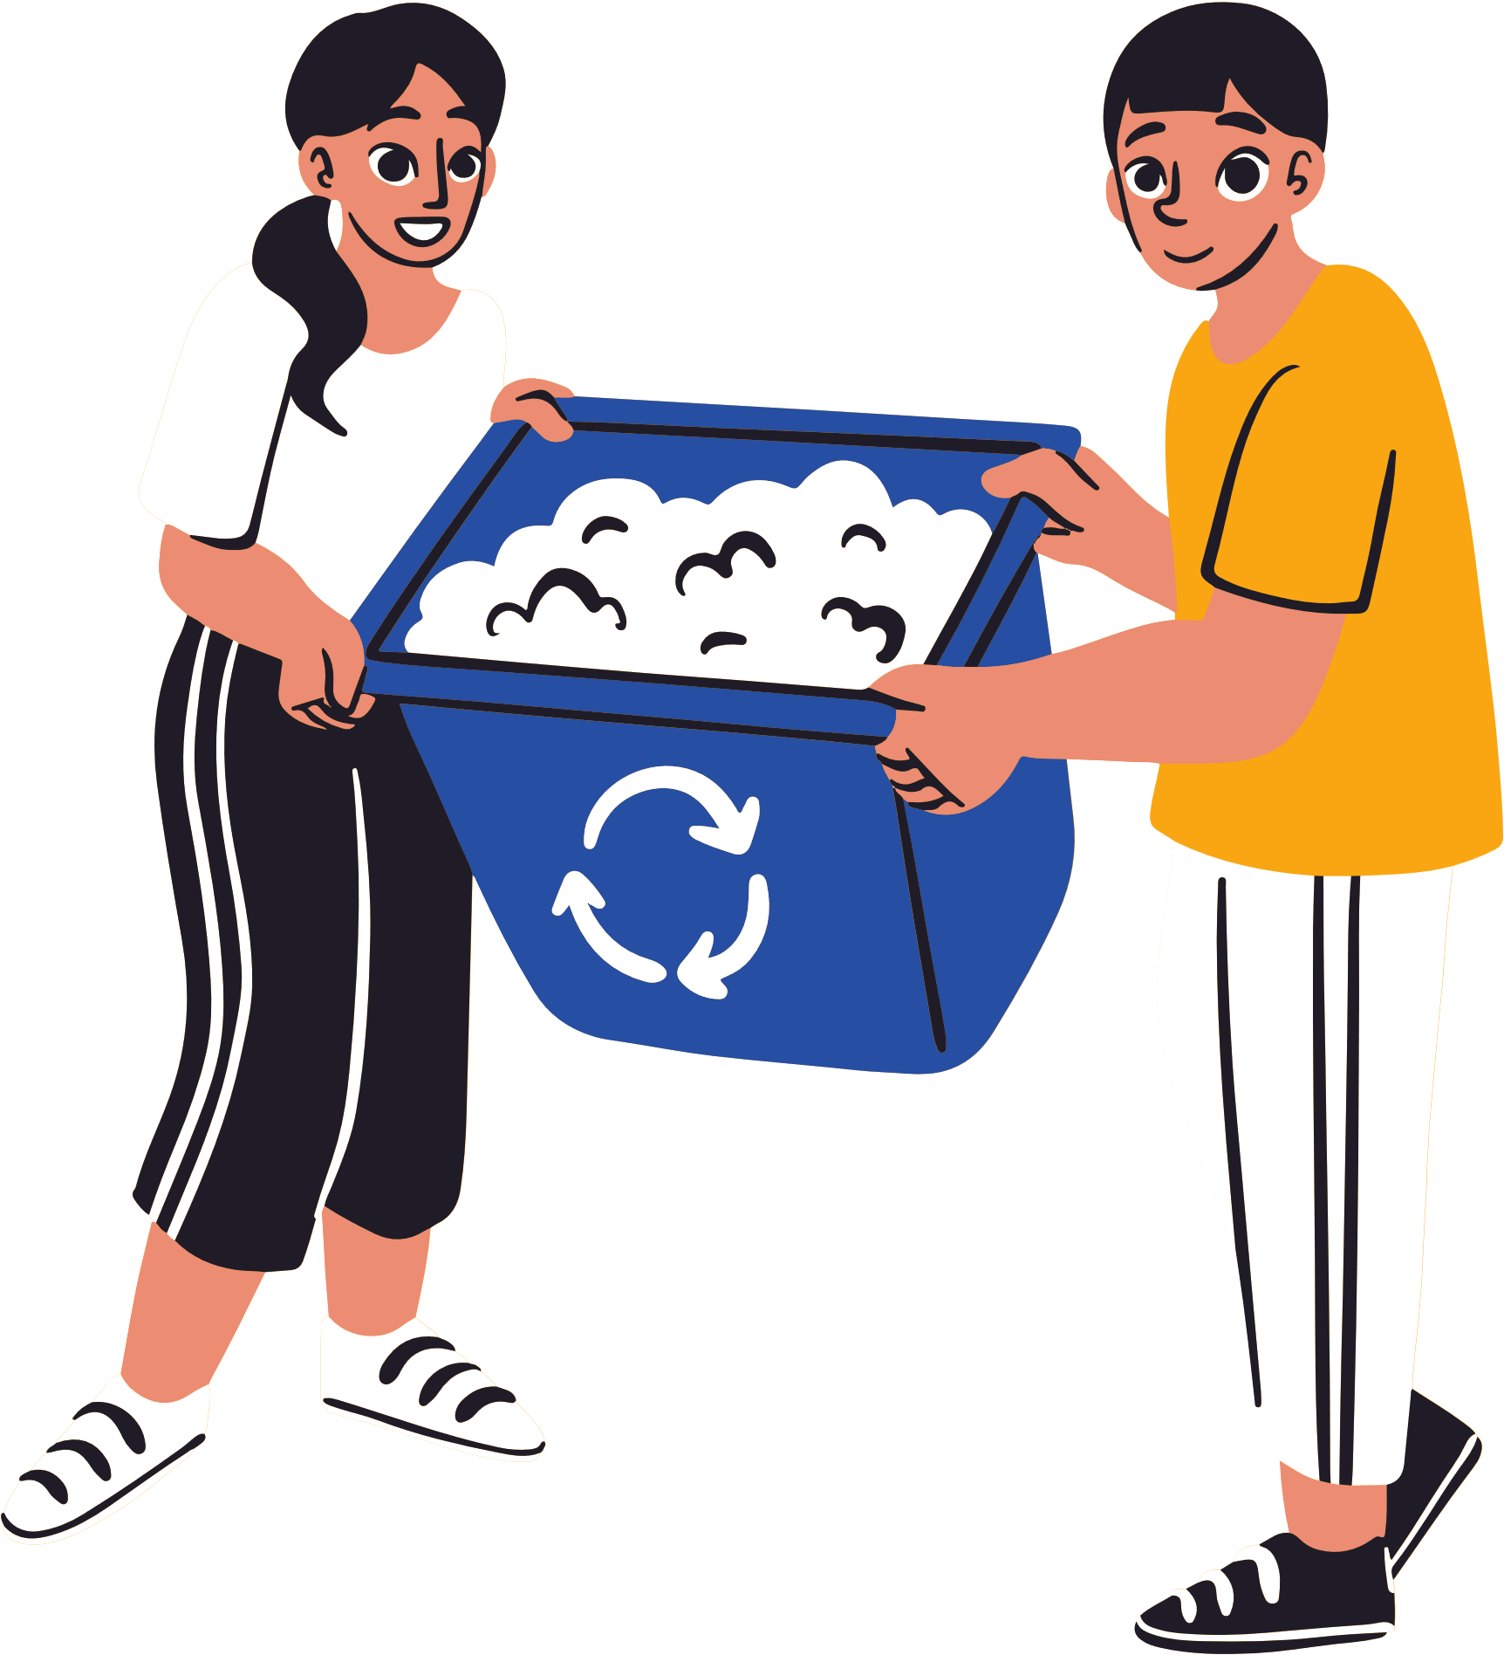
Gamification
Dynamic Leaderboards
Recycle Together OR Compete against Friends

Slide 8
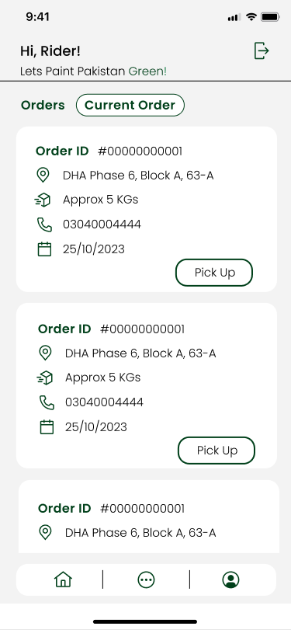
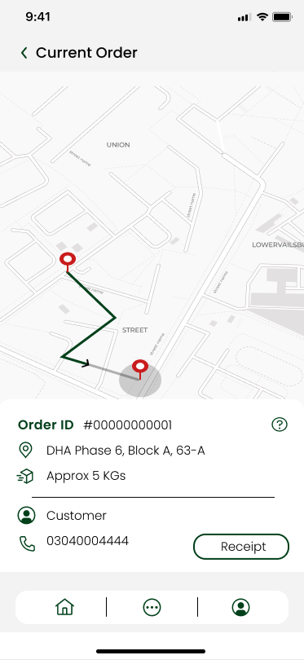

Dedicated App For Rider
Rider Dashboard
Integrated Maps

Slide 9
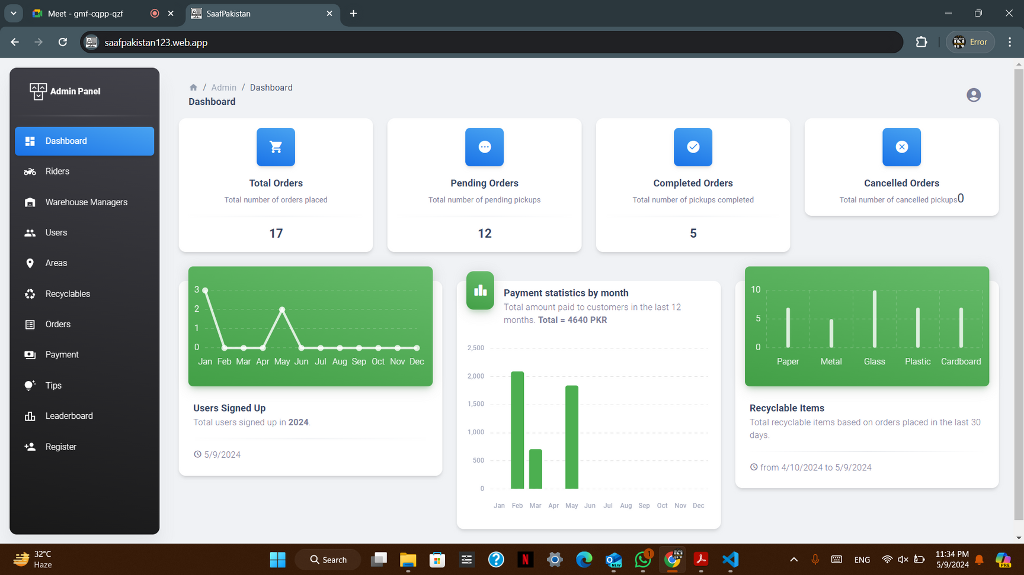
Admin Panel
Centralized hub for managing and overseeing system functionalities, user accounts, and data.

Slide 10

Business Model
"Our business model is simple: We buy Recyclabes at competitive rates from consumers (B2C) and businesses (B2B) and sell at premium rates to recycling centers, creating a sustainable and profitable recycling ecosystem."

Slide 11
Revenue Model
Item | Recycle Center Buying Rates (PKR/KG) | Consumer Selling Rates (PKR/KG)
Plastic | 90 | 70
Steel | 260 | 230
Paper | 100 | 80
Cardboard | 36 | 20
Item | Recycle Center Buying Rates (PKR/KG) | Business/Industries Selling Rates (PKR/KG)
Paper | 100 | 57
Fabric Waste | 90 | 58
Paper Cones | 50 | 32
L/Cut Pieces | 150 | 117
Source: Cheema Metal Scraps
Source: Active Apparels PVT LTD
Source: Warraich Scrap Dealers
Source: Three Stars Hosiery Mills PVT LTD

Slide 12
Revenue Model
[1]
[2]
Out of the 2695 tons only 27% is being recycled, leaving 1967 tons of valuable recyclable waste up for grabs on daily basis
For Consumers side of the model 24rs per kg is the average gross profit
With just 50 tons monthly we expect to generate a revenue of 1.2 Million PKR
For Businesses side of the model 31.5rs per kg is the average gross profit
With just 100 tons monthly we expect to generate a revenue of 3.15 Million PKR
Average cost to run the business would be between 35-40% of the gross profit.
Leaving us with a net profit of 2.61 Million PKR with just 150 Tons/Month
Waste Management in Pakistan (2022)by the U.S. Trade and Development Agency
Azam, M., et al. (2019). "Status, characterization, and potential utilization of municipal solid waste as a renewable energy source: Lahore case study in Pakistan."

Slide 13
Competitor Analysis
Local Scrap Collectors
SaafPakistan
Established relationships
Operational flexibility
Local material knowledge
Tech-driven approach
Structured scheduling
Gamifiation and incentives
Education on recycling
Compliant with environmental standards
No formal schedules
Inefficiencies without tech
Limited scalability
Minimal regulation adherence

Slide 14
Impact Analysis
Reduces landfill usage by utilizing private-controlled warehouses for recycling.
Alleviates government financial burdens by decreasing municipal waste management costs.
Minimizes waste accumulation, promoting cleaner urban environments.
Fosters innovation with opportunities for new waste management practices.
Attracts foreign investment in sustainable technologies and carbon reduction.

Slide 15
Team Members
Ali Sher
BSc Hons Software Engineering (BNU- Lahore)
Nouman Ali
BSc Hons Software Engineering (BNU- Lahore)
Mian Faizan Munawer
BSc Hons Software Engineering (BNU- Lahore)

Slide 16
THANK YOU VERY MUCH!

